Slide 1
Data preprocessing

Slide 2
Handling Missing Values

Slide 3
Categorical Variables
Label Encoding
One Hot Encoding

Slide 4
Label Encoding

Slide 5
One Hot Encoding

Slide 6
Feature Scaling
Standardization
Normalisation

Slide 8
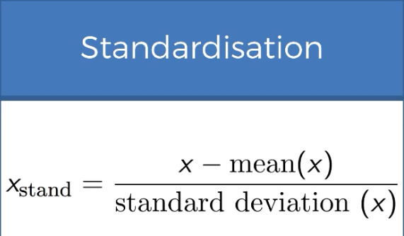
Standardisation

Slide 9
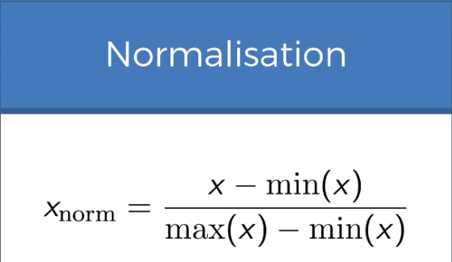
Normalisation

